Slide 1

Dysregulation of SLC1A3 in AUD and alcohol-associated behaviors
Aryan Mangla, Mayfield Lab
Notes:
Hey guys, I am Aryan, a junior researcher under Mayfield Lab and my presentation is on the Dysregulation of the SLC1A3 gene in Alcohol Use Disorder or AUD and its associated behaviors in mice models.

Slide 2
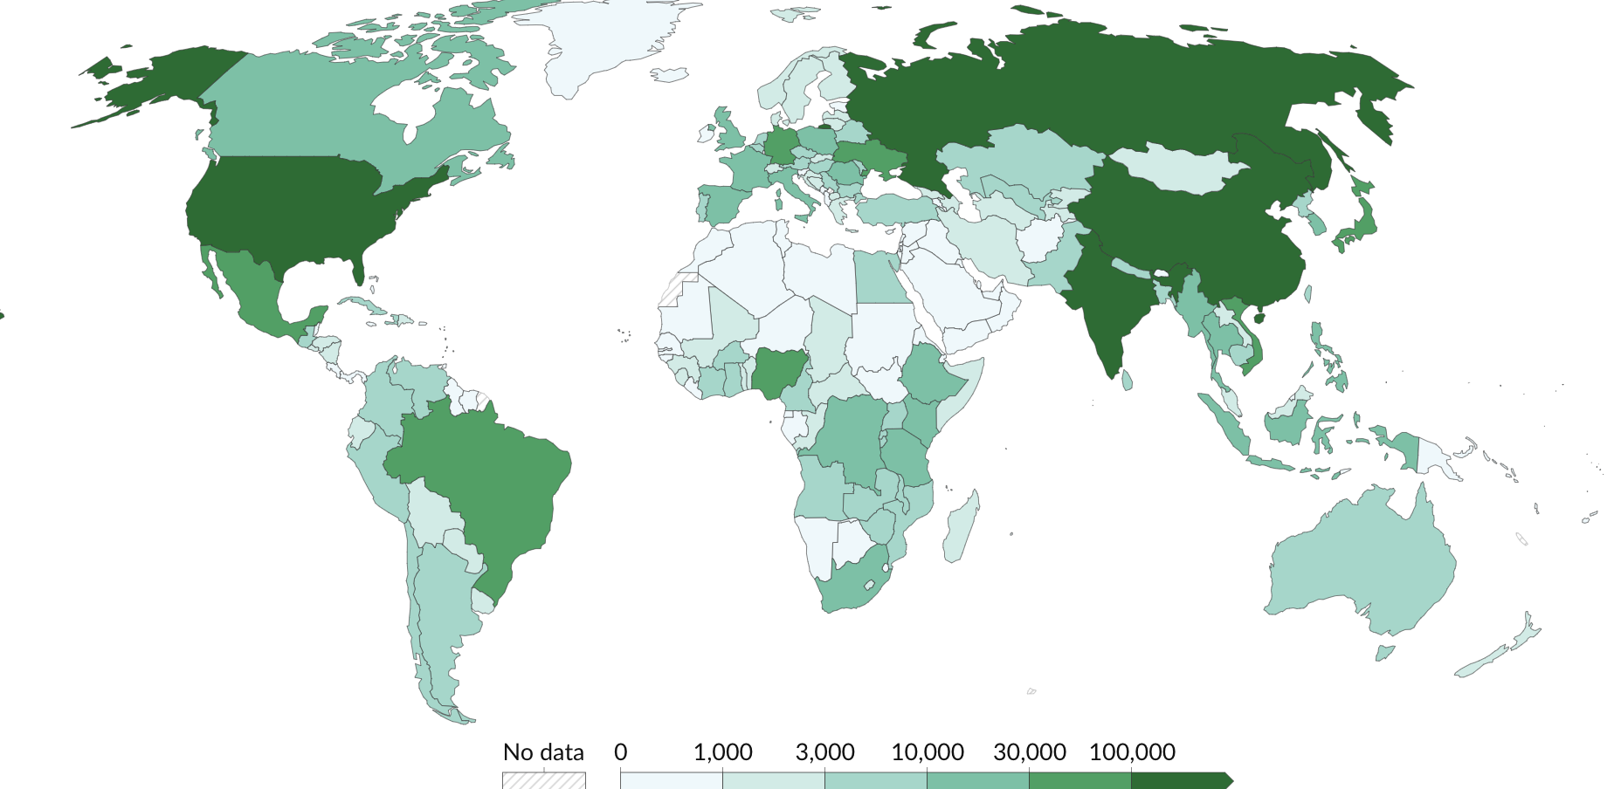
Alcohol use is a large public health problem
Alcohol Global Impact
Alcohol use contributes to ~5% of the global burden of disease and injury (2.4 million deaths annually).
Alcohol Use Disorder (AUD) is a significant contributor to alcohol-related burden, affecting ~11% of the US population (NIAAA)
AUD is characterized by:
Loss of control over alcohol intake
Drinking continues despite negative consequences (“compulsivity”)
Preference of alcohol over natural rewards
DSM-5 focuses on behavioral patterns over the quantity of alcohol consumption.
These behavioral symptoms reflect persistent neuroadaptations in key brain structures that control motivated behavior
Our World in Data 2021
Notes:
Let's begin by addressing a significant global health concern: alcohol use and its widespread impact. Alcohol use contributes to about 5% of the global burden of disease and injury, which is around 2.4 million deaths. A major contributor to this burden is AUD, which affects about 11% of the U.S. population. This model displays the population with AUD in the world.
AUD is a medical condition in which people continue to drink despite facing serious negative consequences, also known as compulsivity. The DSM-5 is a system used to diagnose mental health condition. Their criteria for AUD focuses more on the behavioral patterns associated with alcohol consumption rather than just the quantity of alcohol consumed, highlighting that these behaviors are not simply habits, but are reflections of persistent neuroadaptations in brain structures that control motivated behavior.

Slide 3
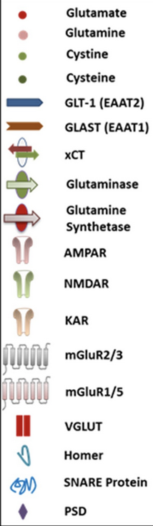
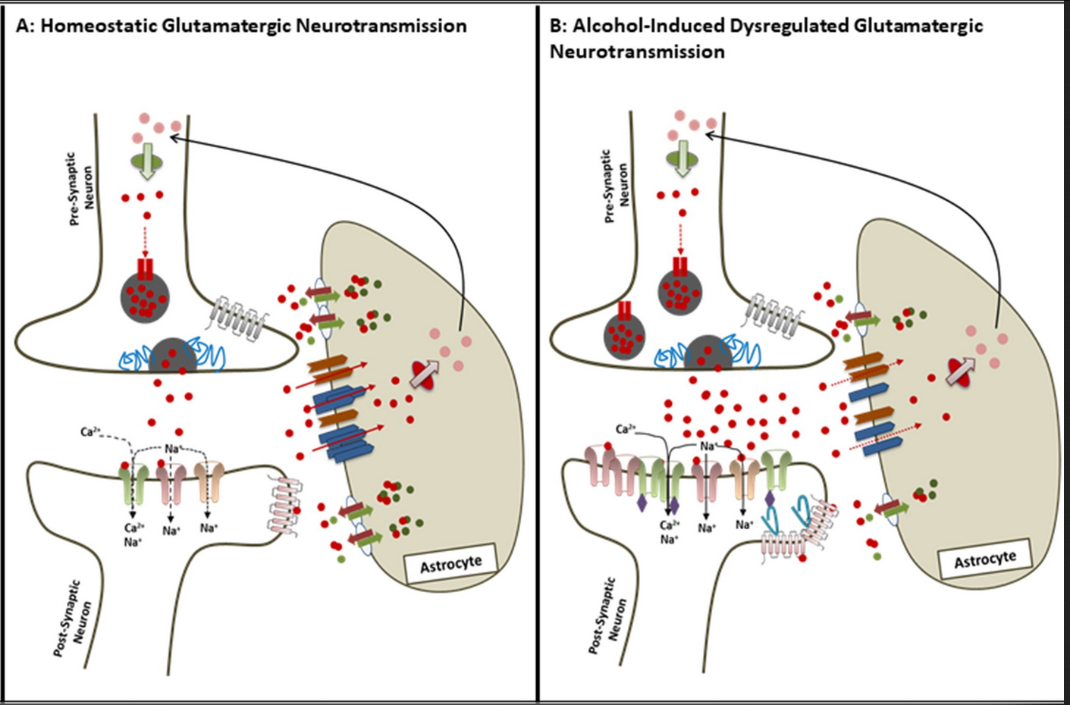
Alcohol disrupts glutamate homeostasis – ‘via GLT-1 downregulation’
Primary Glu transporters are SLC1A2 and SLC1A3 (Glast)
SLC1A2 is more abundant (~1% of total brain protein)
Glast is 4-6 times less abundant than SLC1A2
Extracellular Glu reuptake by SLC1A2/SLC1A3
Chronic alcohol exposure and withdrawal lead to elevated levels of extracellular glutamate
GLT-1 (SLC1A2):
Cocaine, opioids, ethanol, nicotine, and amphetamines have each been shown to affect GLT-1 expression and glutamate uptake; mainly in the nucleus accumbens and prefrontal cortex
Reviews: Alasmari et al., 2018; Roberts-Wolfe & Kalivas 2015
Notes:
Moving on to how alcohol affects the brain at the molecular level, one key mechanism is the disruption of glutamate homeostasis. Glutamate is the primary excitatory neurotransmitter in the brain, and maintaining its balance is crucial for proper functioning. The two main glutamate transporters are SLC1A2 and SLC1A3 or GLAST. Despite playing a similar role in clearing excess glutamate from the synapse, SLC1A2 is the more abundant transporter. Disruption of glutamate homeostasis is seen through chronic alcohol exposure which leads to elevated glutamate levels meaning that SLC1A2 expression is sensitive to alcohol as well as other substances like cocaine, nicotine, and amphetamines. Therefore, SLC1A2 has been a target in reversing this imbalance by enhancing protein production. However, in our lab we see GLAST being dysregulated more than its big brother.

Slide 4
In our experiments, Glast is frequently found dysregulated
Downregulated in astrocytes from mPFC – EOD-2BC
(Every Other Day 2-Bottle Choice)
Downregulated in astrocytes and bulk tissue – CIE
(Chronic Intermittent Exposure)
Downregulation but normalized by 72 hours
(Farris et al 2020)
Glast
(Erickson et al 2019.a)
(Erickson et al 2019.a)
Upregulated in PFC from astrocytes and microglia from alcohol-dependent humans
Astrocyte co expression module upregulated in mPFC after CIE.
(Salem et al., 2024)
(Brenner et al 2020)
Notes:
Now, let's focus on the previous studies validating GLAST’s response across different experiments. GLAST has been frequently downregulated in astrocytes rich cells using EOD-2BC paradigm, while a CIE paradigm included both astrocytes and bulk tissue responses. Another CIE experiment, revealed GLAST levels returning to normal after 72 hours.
On the contrary, GLAST has been upregulated in astrocyte and microglia rich cells from alcohol dependent humans. And lastly, Nihal Salem, a postdoc in my Mayfield Lab has recently identified an astrocyte co-expression module that is upregulated after CIE. This is important because it reveals a cluster of genes working in concert to regulate glutamate homeostasis. Finally, I will walk you through a set of validation experiments we conducted using a viral vector to knock down GLAST expression to learn more about its role.

Slide 5
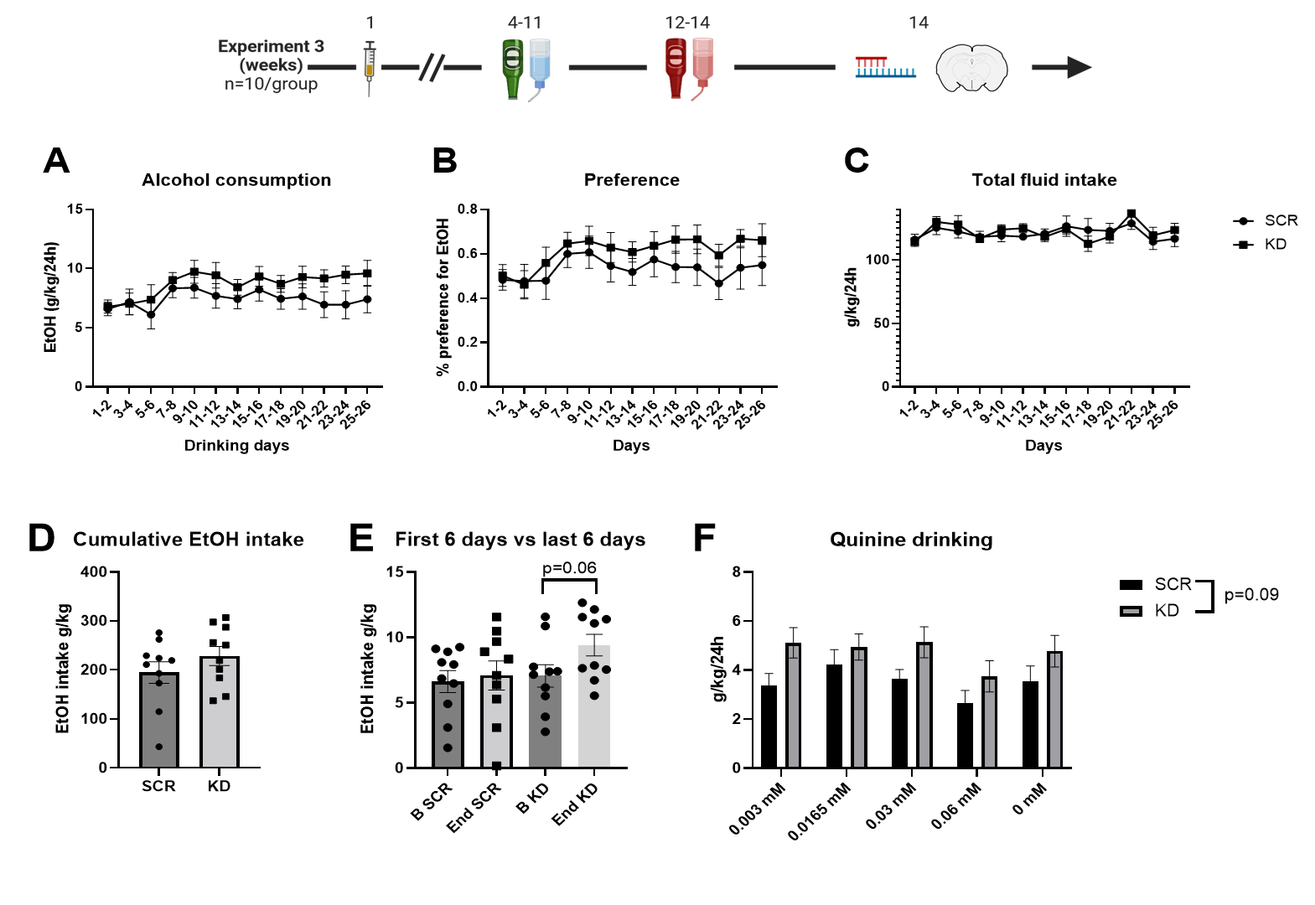
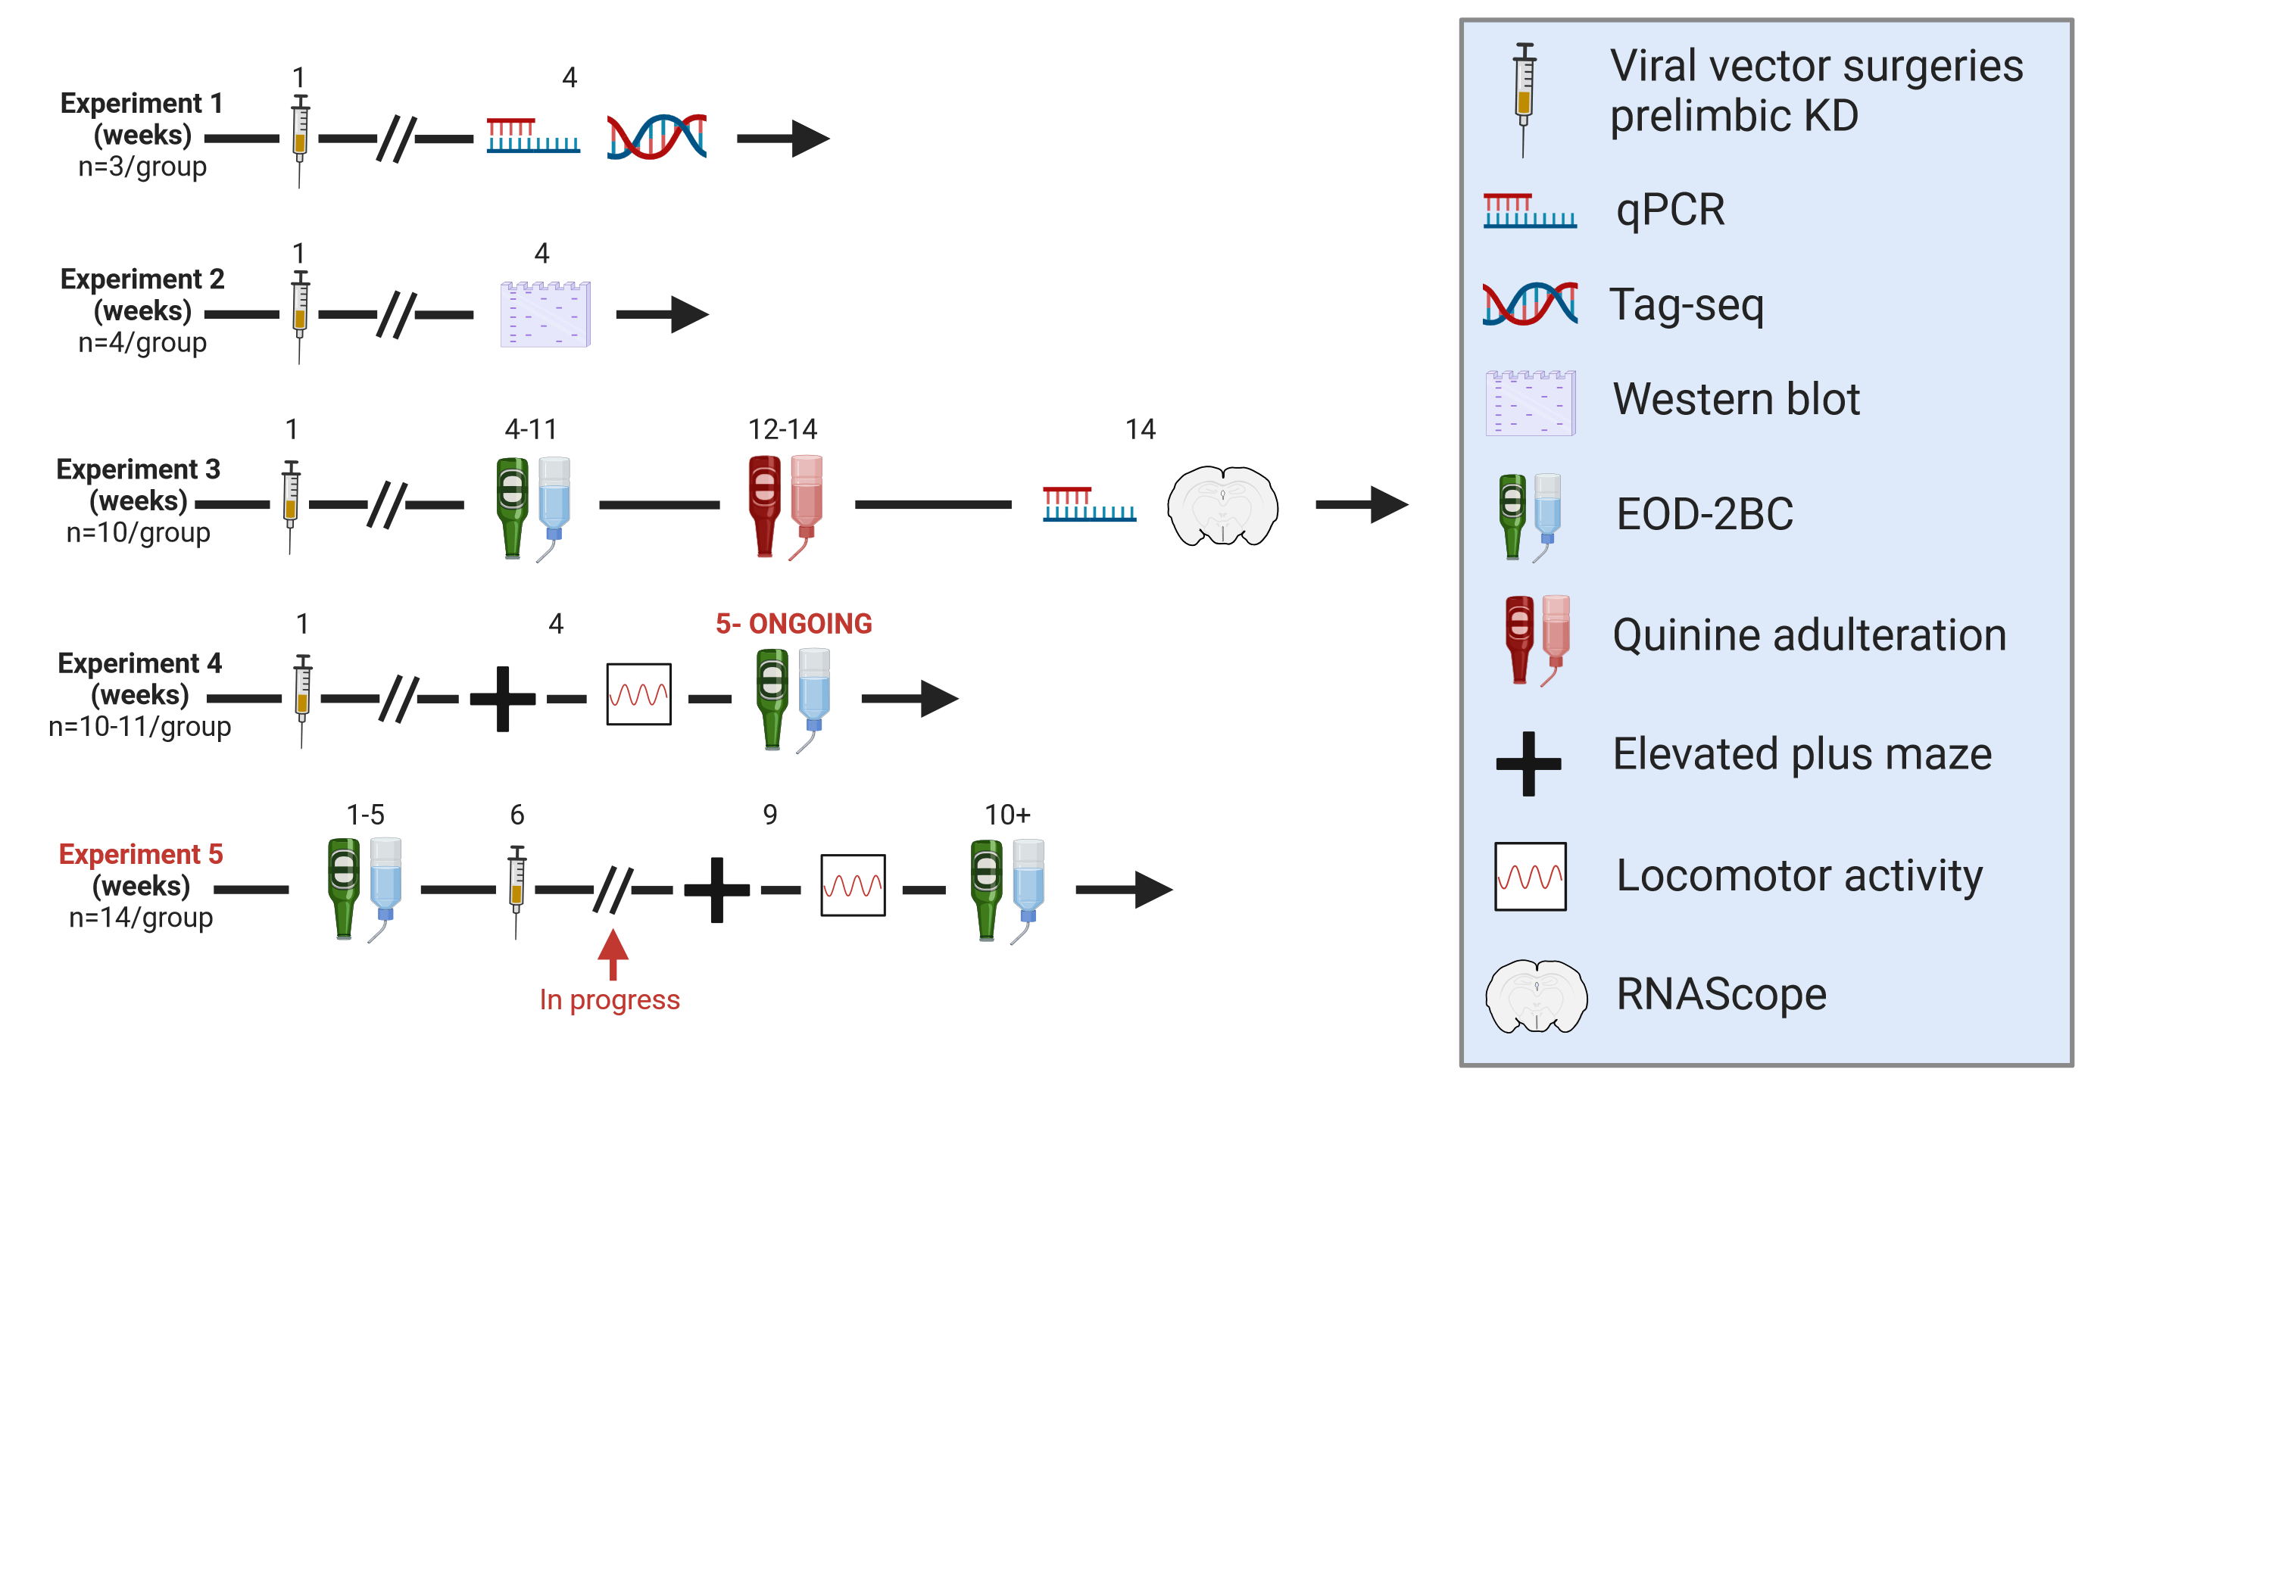
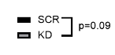
Glast KD in the dmPFC resulted in a small but stable increase in alcohol consumption in mice
Notes:
So, here’s the first experiment examining the effects of GLAST knockdown in the dorsal medial prefrontal cortex or dmPFC on alcohol consumption. We first conducted viral vector surgeries to knock down GLAST on the first week led by a recovery phase of 2 weeks. On the 4th week, we placed the KD group of 10 mice, alongside 10 scrambled controls through a 15% ethanol EOD-2BC paradigm. An Every other Day 2 bottle choice or EOD-2BC is a paradigm in which animals are presented with two bottles, one containing alcohol and the other with water, which allows us to measure voluntary consumption and its preferences. After the final week of drinking, we observed that the KD animals had a small but stable increase in alcohol consumption (A). Although this increase wasn’t statistically significant, it was present at a trend level. The KD animals also had a higher preference for alcohol (B), leading to a similar effect on the cumulative ethanol consumption (D).
This urged us to explore GLAST’s influence on compulsive-like drinking behaviour. To test this, we added a quinine, a bitter tastant between weeks 12 to 14. Rodents typically avoid this bitter tastant, reducing their alcohol consumption. Animals that resist this reduction are considered to show compulsive-like drinking behaviour. In our experiment, the KD animals shown with the lighter color (F) resulted in a maintenance of their small increase in intake, despite not seeing any resistance to the quinine. This suggests that while their intake was slightly higher, it wasn’t driven by compulsive-like behaviour, hinting that GLAST might regulate alcohol consumption in a different way.

Slide 6
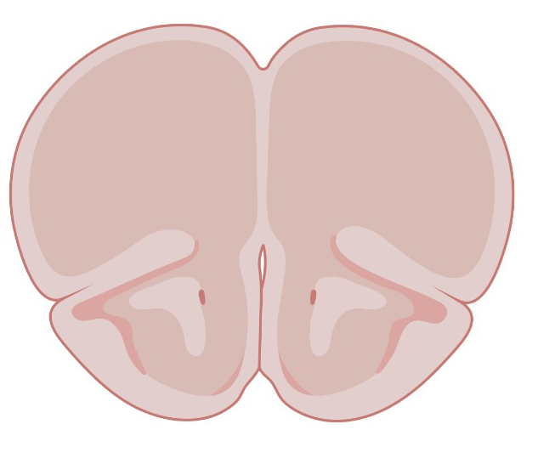
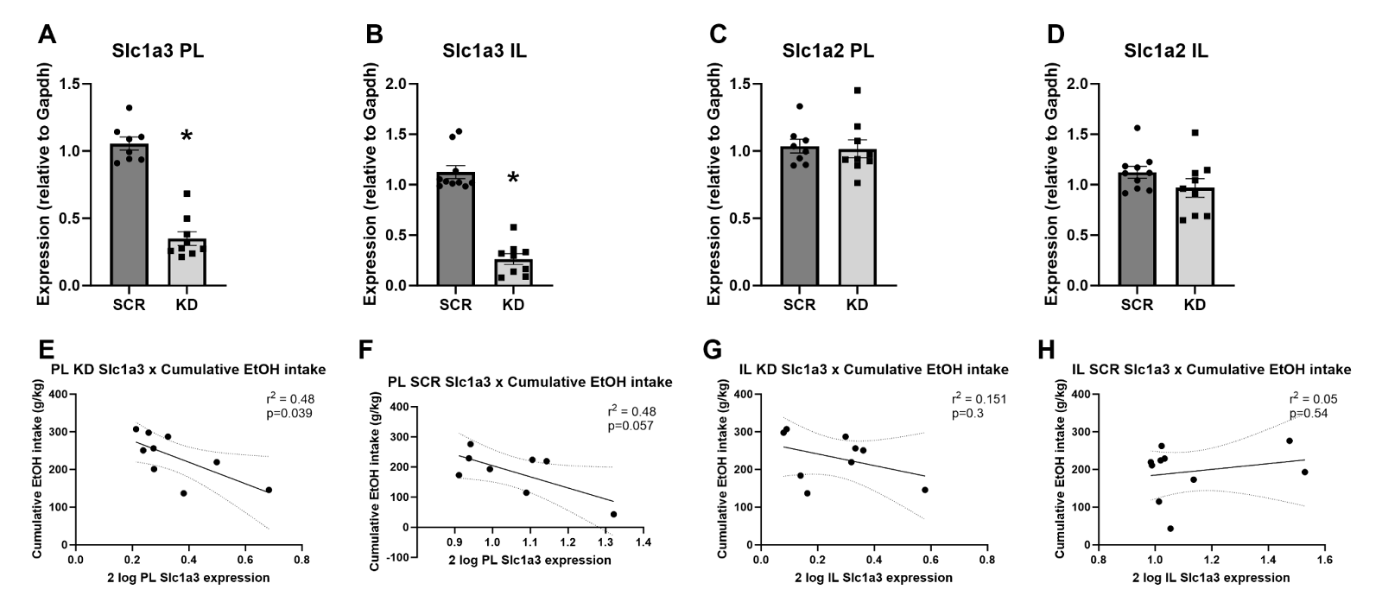
Expression levels of prelimbic Glast inversely correlated with cumulative voluntary EtOH intake
Prelimbic Cortex (PL)
Notes:
To dig deeper into the relationship between GLAST expression and alcohol consumption, we performed qPCR to measure expression levels to validate our viral construct, specifically on the prelimbic (PL) cortices which is involved in controlling motivated behaviour. As seen in figure A, our viral vector successfully knocked down GLAST, however through figure C, we can observe that there wasn’t any compensatory changes in SLC1A2 expression, meaning that despite the strong downregulation of GLAST, SLC1A2 levels remained unaffected.
Next, we looked at the correlation between GLAST expression and cumulative alcohol intake in figure E and F. What see is a robust inverse correlation. The lower the GLAST expression, the more the mice drank. This suggests that GLAST expression in the PL plays a clear role in regulating drinking behaviour.

Slide 7
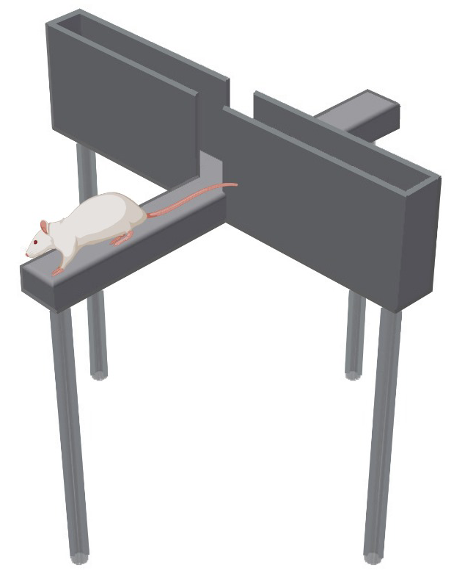
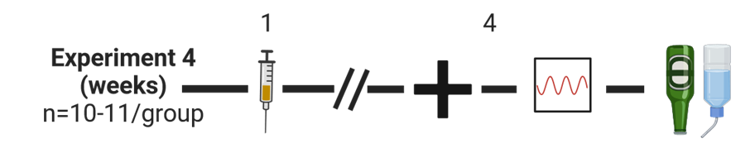
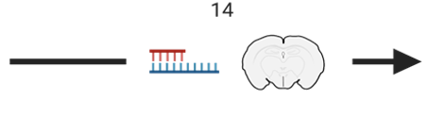
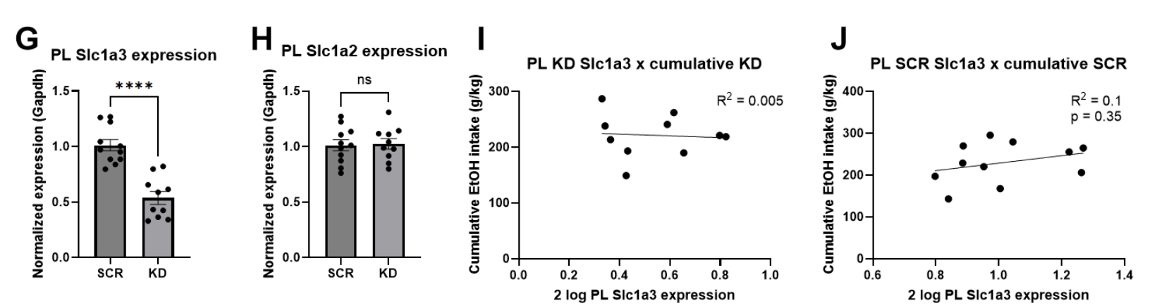
In a separate experiment, KD of Glast in the dmPFC showed no effect
5-12
Notes:
Next, we moved forward with two experiments. The first was essentially a replication of the previous study, but with the addition of behavioural assessments before drinking. These behavioural experiments included elevated plus maze (EPM) to measure anxiety-like behaviour and locomotion for control behaviours. EPM is a behavioural test consisting of four arms, two of which are open (without walls) and two are closed (with walls). The open arms represent anxiety-inducing environment, mimicing an exposed environment, while the closed arms offers a sense of safety. In our EPM experiment, we didn’t observe any significant effects, however, there was a slight trend suggesting that GLAST KD might produce an anxiolytic effect (reducing anxiety) as seen through KD animals spending more time in the open arm compared to the SCR controls. After behavioural, we replicated the drinking experiment, in which we didn’t observe any significant effect of GLAST KD on alcohol consumption. Instead, in the right two figures, we see that the scrambled control animals drank a bit more compared to the KD animals. This result was unexpected, especially since the prior experiment also showed a small increase in alcohol intake with GLAST KD. Overall, this experiment didn’t yield strong effects on ethanol intake or anxiety, but the trends warranted further exploration.

Slide 8
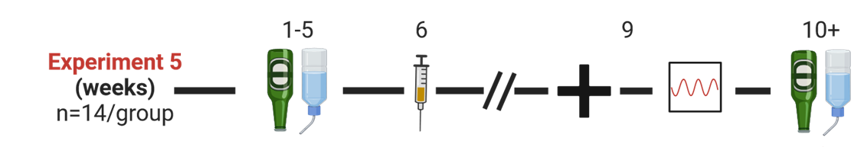
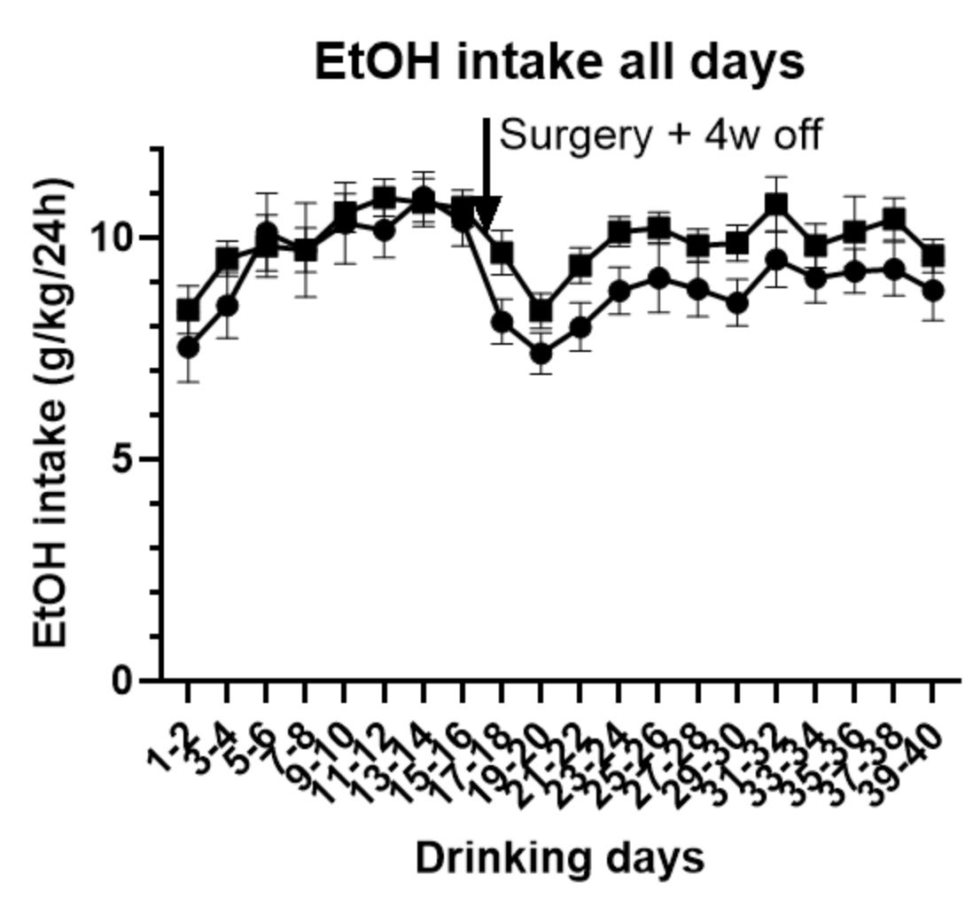
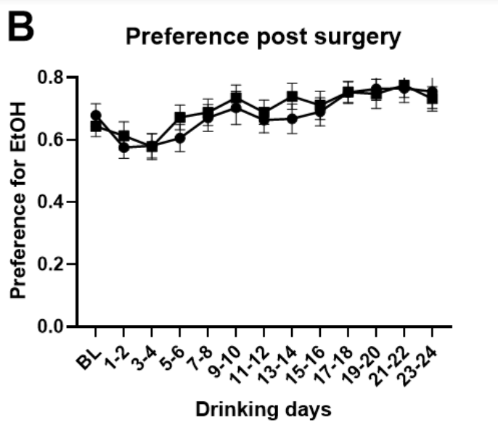
Effect of prior exposure to EtOH on Glast KD in the dmPFC
A
Notes:
In our last experiment, we included drinking before surgery to see whether prior exposure to alcohol alters the effect of GLAST knockdown (KD). The results on alcohol intake were underwhelming and wasn’t replicative of previous experiments trend lines as we can see on the first two figures, that both SCR and KD animals have the similar measurements.
However, the behavioural aspect of this experiment resulted in a stronger anxiolytic effect in this batch of mice with prior alcohol exposure compared to the previous experiment. In last figure, the KD animals spend a significant more time in the open arms, meaning that the KD animals had significant reduction in anxiety-like behaviour in comparison to the SCR control mice. This suggests that prior alcohol exposure might amplify the effect of GLAST KD on anxiety-like behaviour, making the animals less anxious.

Slide 9
Discussion
Glast is dysregulated following alcohol consumption in both humans and mice, more so than Glt-1 in our data
KD of Glast in the dmPFC does not appear to reliably change EtOH intake or preference, despite the robust inverse correlation between GLAST expression and alcohol intake
Glast KD in the PL appear to have an anxiolytic effect suggesting that Glast might play a nuanced role in modulating anxiety-like behaviors
Notes:
In summary, our data suggest that GLAST is consistently dysregulated following alcohol consumption. This dysregulation appears more pronounced than that of SLC1A2, at least in our studies. However, when we specifically knocked down GLAST, we did not observe any reliable changes in ethanol intake or preference. This lack of effect on drinking behaviour was unexpected, particularly given the robust inverse correlation between GLAST expression and cumulative alcohol intake.
One of the more surprising findings was the anxiolytic effect of GLAST knockdown. While GLAST KD does not seem to affect alcohol consumption consistently, the anxiolytic effects has, warranting further investigation. It is possible that GLAST plays a more nuanced role in regulating anxiety-like behaviours than controlling alcohol intake.

Slide 10
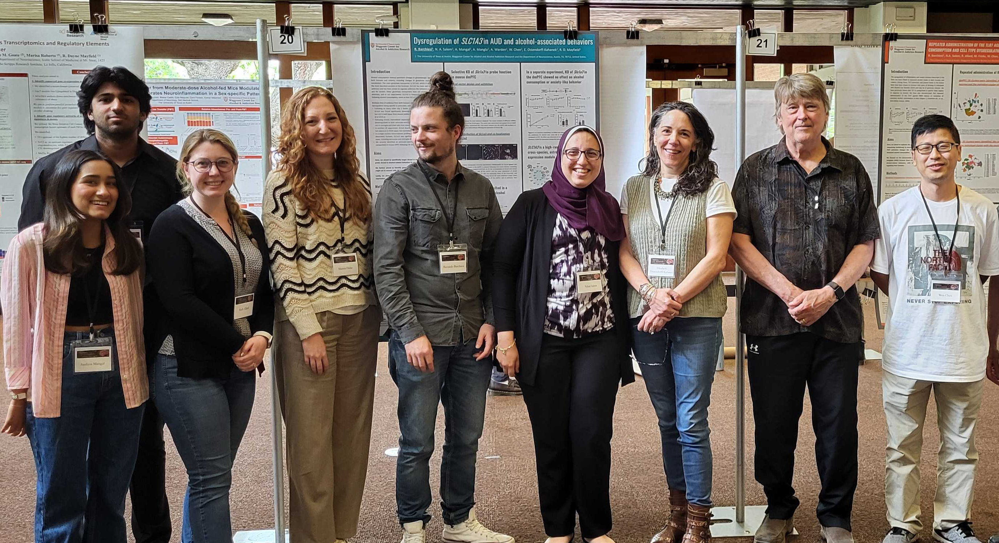

Thank you for your attention!
Mayfield Lab Dayne Mayfield Elizabeth Osterndorff-Kahanek
Nihal Salem Marion Friske
Anna Warden
Wen Chen
Ruth Allard
Aashna Mangal Aryan Mangla
Jessica McFarland
Jody Mayfield Jayna Dixon
(Geoff Dilly)
Blednov Lab Yuri Blednov
Sonia Mason Whitney Leigh Hodgson
Microscopy & Imaging Facility Anna Webb
Paul Oliphint
Mayfield Lab
UT Genomic Sequencing and Analysis Facility Jessica Podnar
Holly Stevenson
John Ludes-Meyers
This research was supported by funding from the National Institutes of Health (R01 AA012404 and U01 AA020926 to RDM; K00 AA029955 to NAS).
Notes:
I would like to thank all of the individuals who contributed to this work. The research presented here would not have been possible without the hard work and dedication of the Mayfield Lab. A special thanks to Riccardo Barchiesi for spearheading this research experiment and providing me invaluable experiences and support. Thank you all for your attention!"

